Slide 1

SCW Woodshop
Education Center
By Myrna Barnard

Slide 2

What lurks inside this newly renovated Education Center?

Slide 3
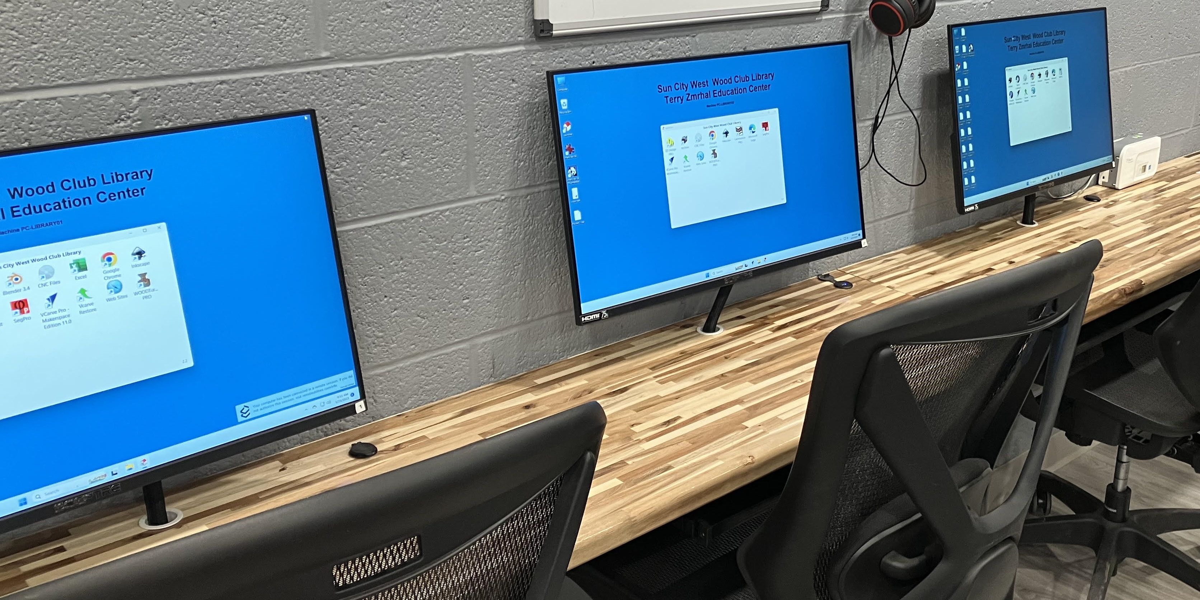

8 Computers
03
02
01
Numbered 01 through 07
With lots of memory
Number 08 in CNC room

Slide 4

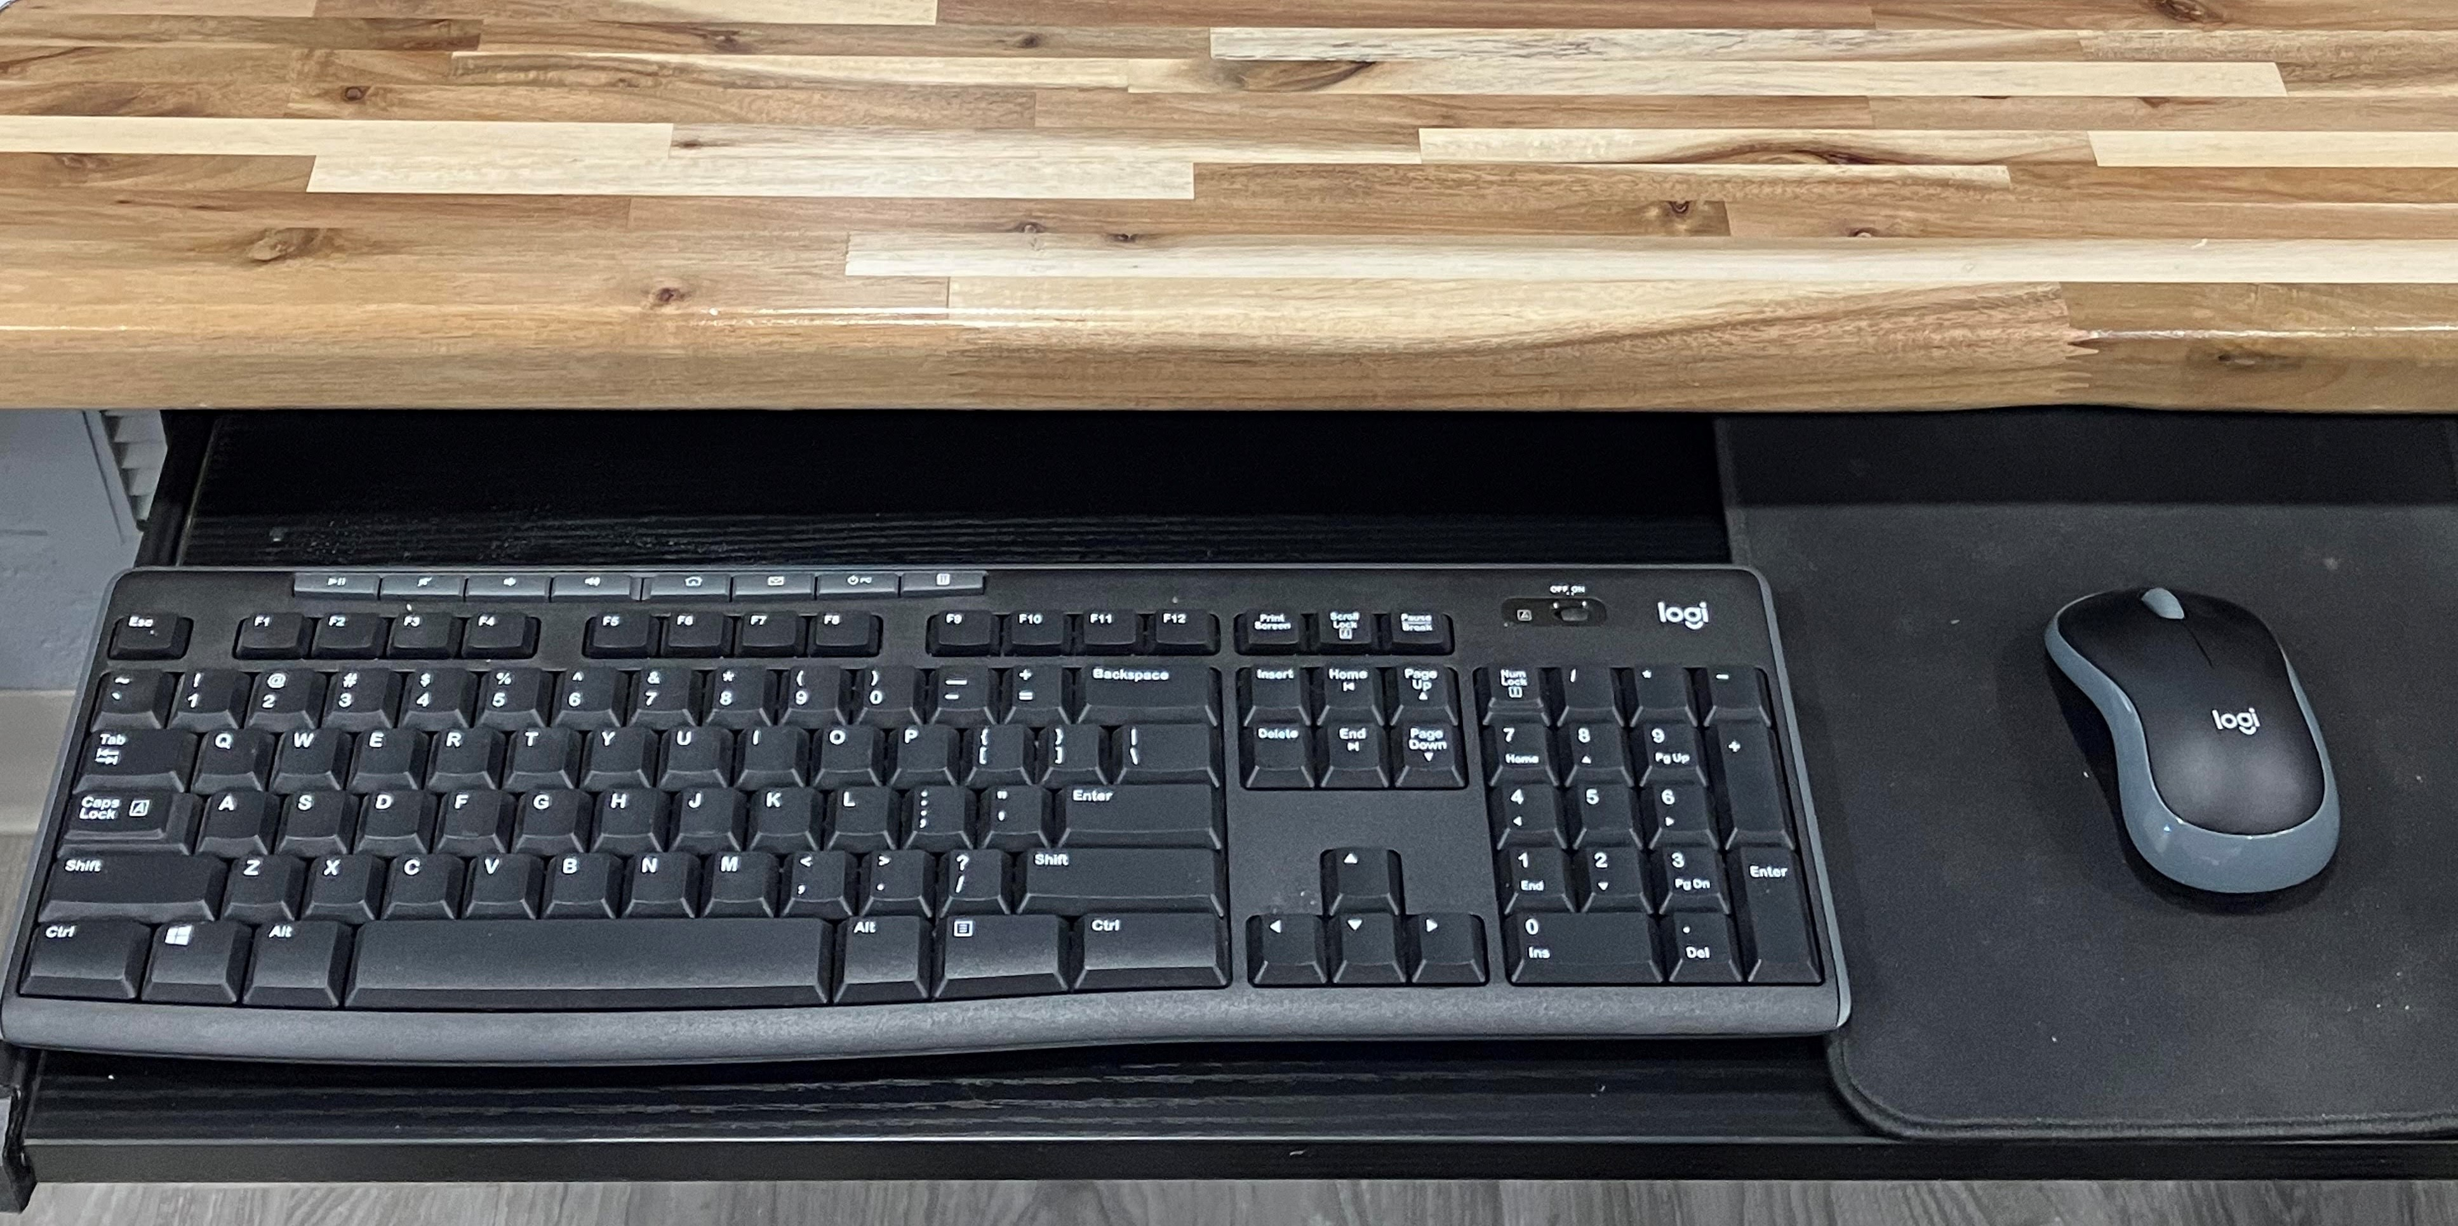
Displays, Keyboards & Mouse
Each computer has a dedicated 27” Screen with Keyboard & Mouse on slideout drawer

Slide 5

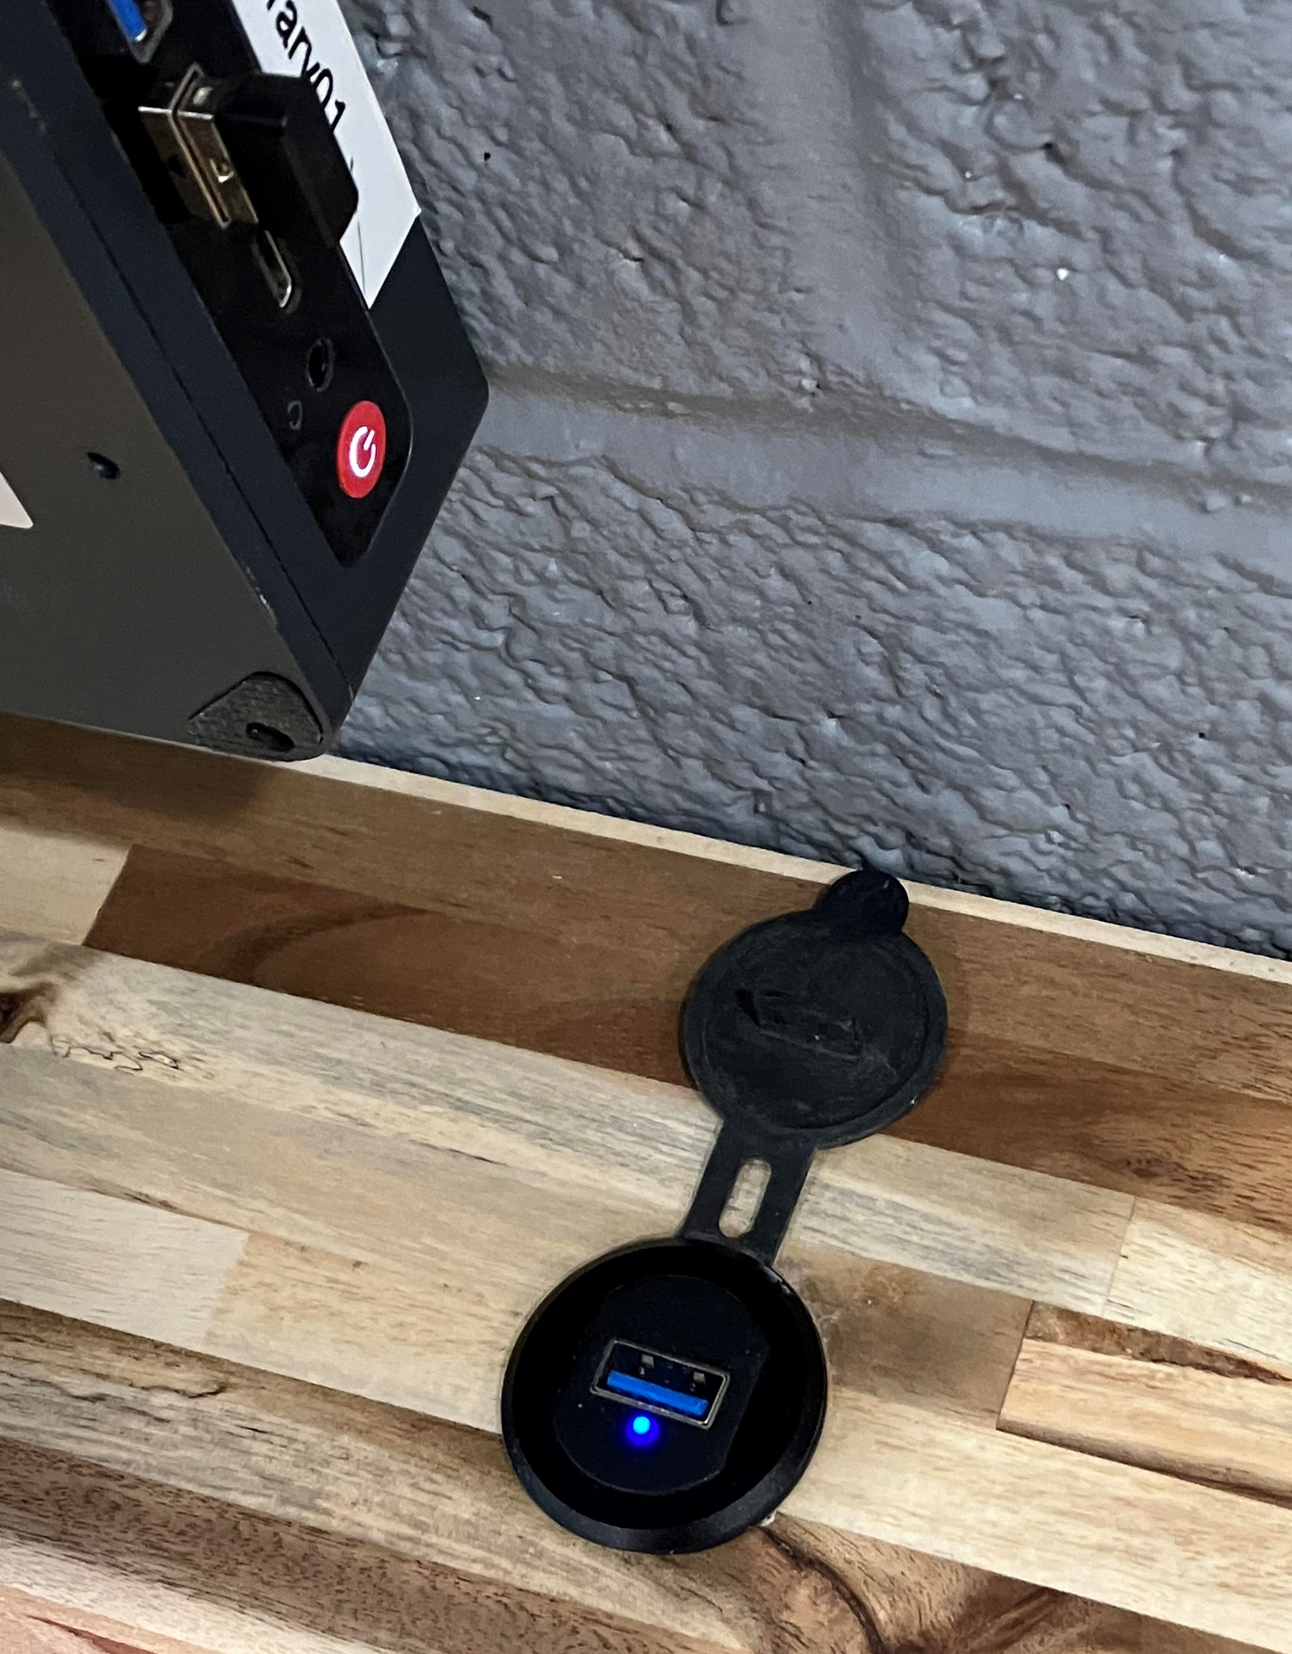
USB Ports
USB Ports available at every workstation located to the right of the screen on the counter.
Dust cover is provided to minimize the dust accumulation.

Slide 6

If the screen is dark merely press a key or click the mouse to wake up the computer from a nap
WAKE UP !!!

Slide 7
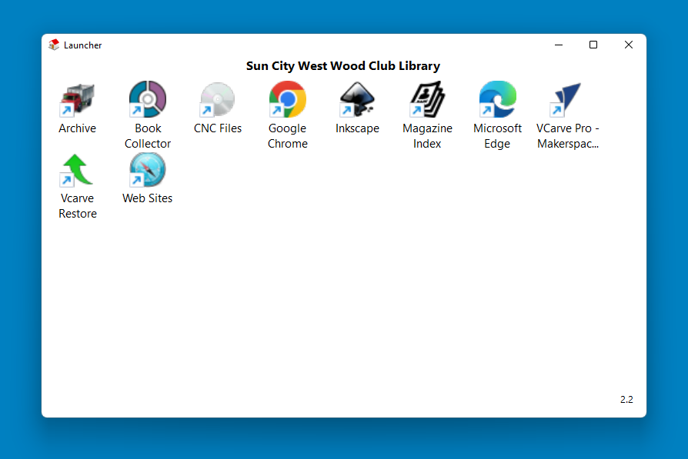

Launcher
Press Launcher icon
To open the Launcher Window
NOT ALL COMPUTERS ARE EQUAL
THE LAUNCHER WINDOW DISPLAYS WHAT APPLICATIONS ARE AVAILABLE ON THAT COMPUTER
Listing of applications showing which software is on which computers is located on the shelving.

Slide 8

Using the Internet
two web browsers – Chrome & Edge
Clicking on either browser will open to the woodshop website
These browsers operate in “GUEST” mode. Which means
for security purposes your passwords will not be saved.

Slide 9

Where Does the Junk Go?
ARCHIVING
Personal data left on computers will be archived for 30 days and then destroyed.
Moral of the Story – Take your data with you when you leave the computer.

Slide 10

And Then There’s WiFi
Strong WiFi Signal Throughout the Shop
One WiFi Unit in CNC Room & One in Library
WiFi Password: wclibrary

Slide 11
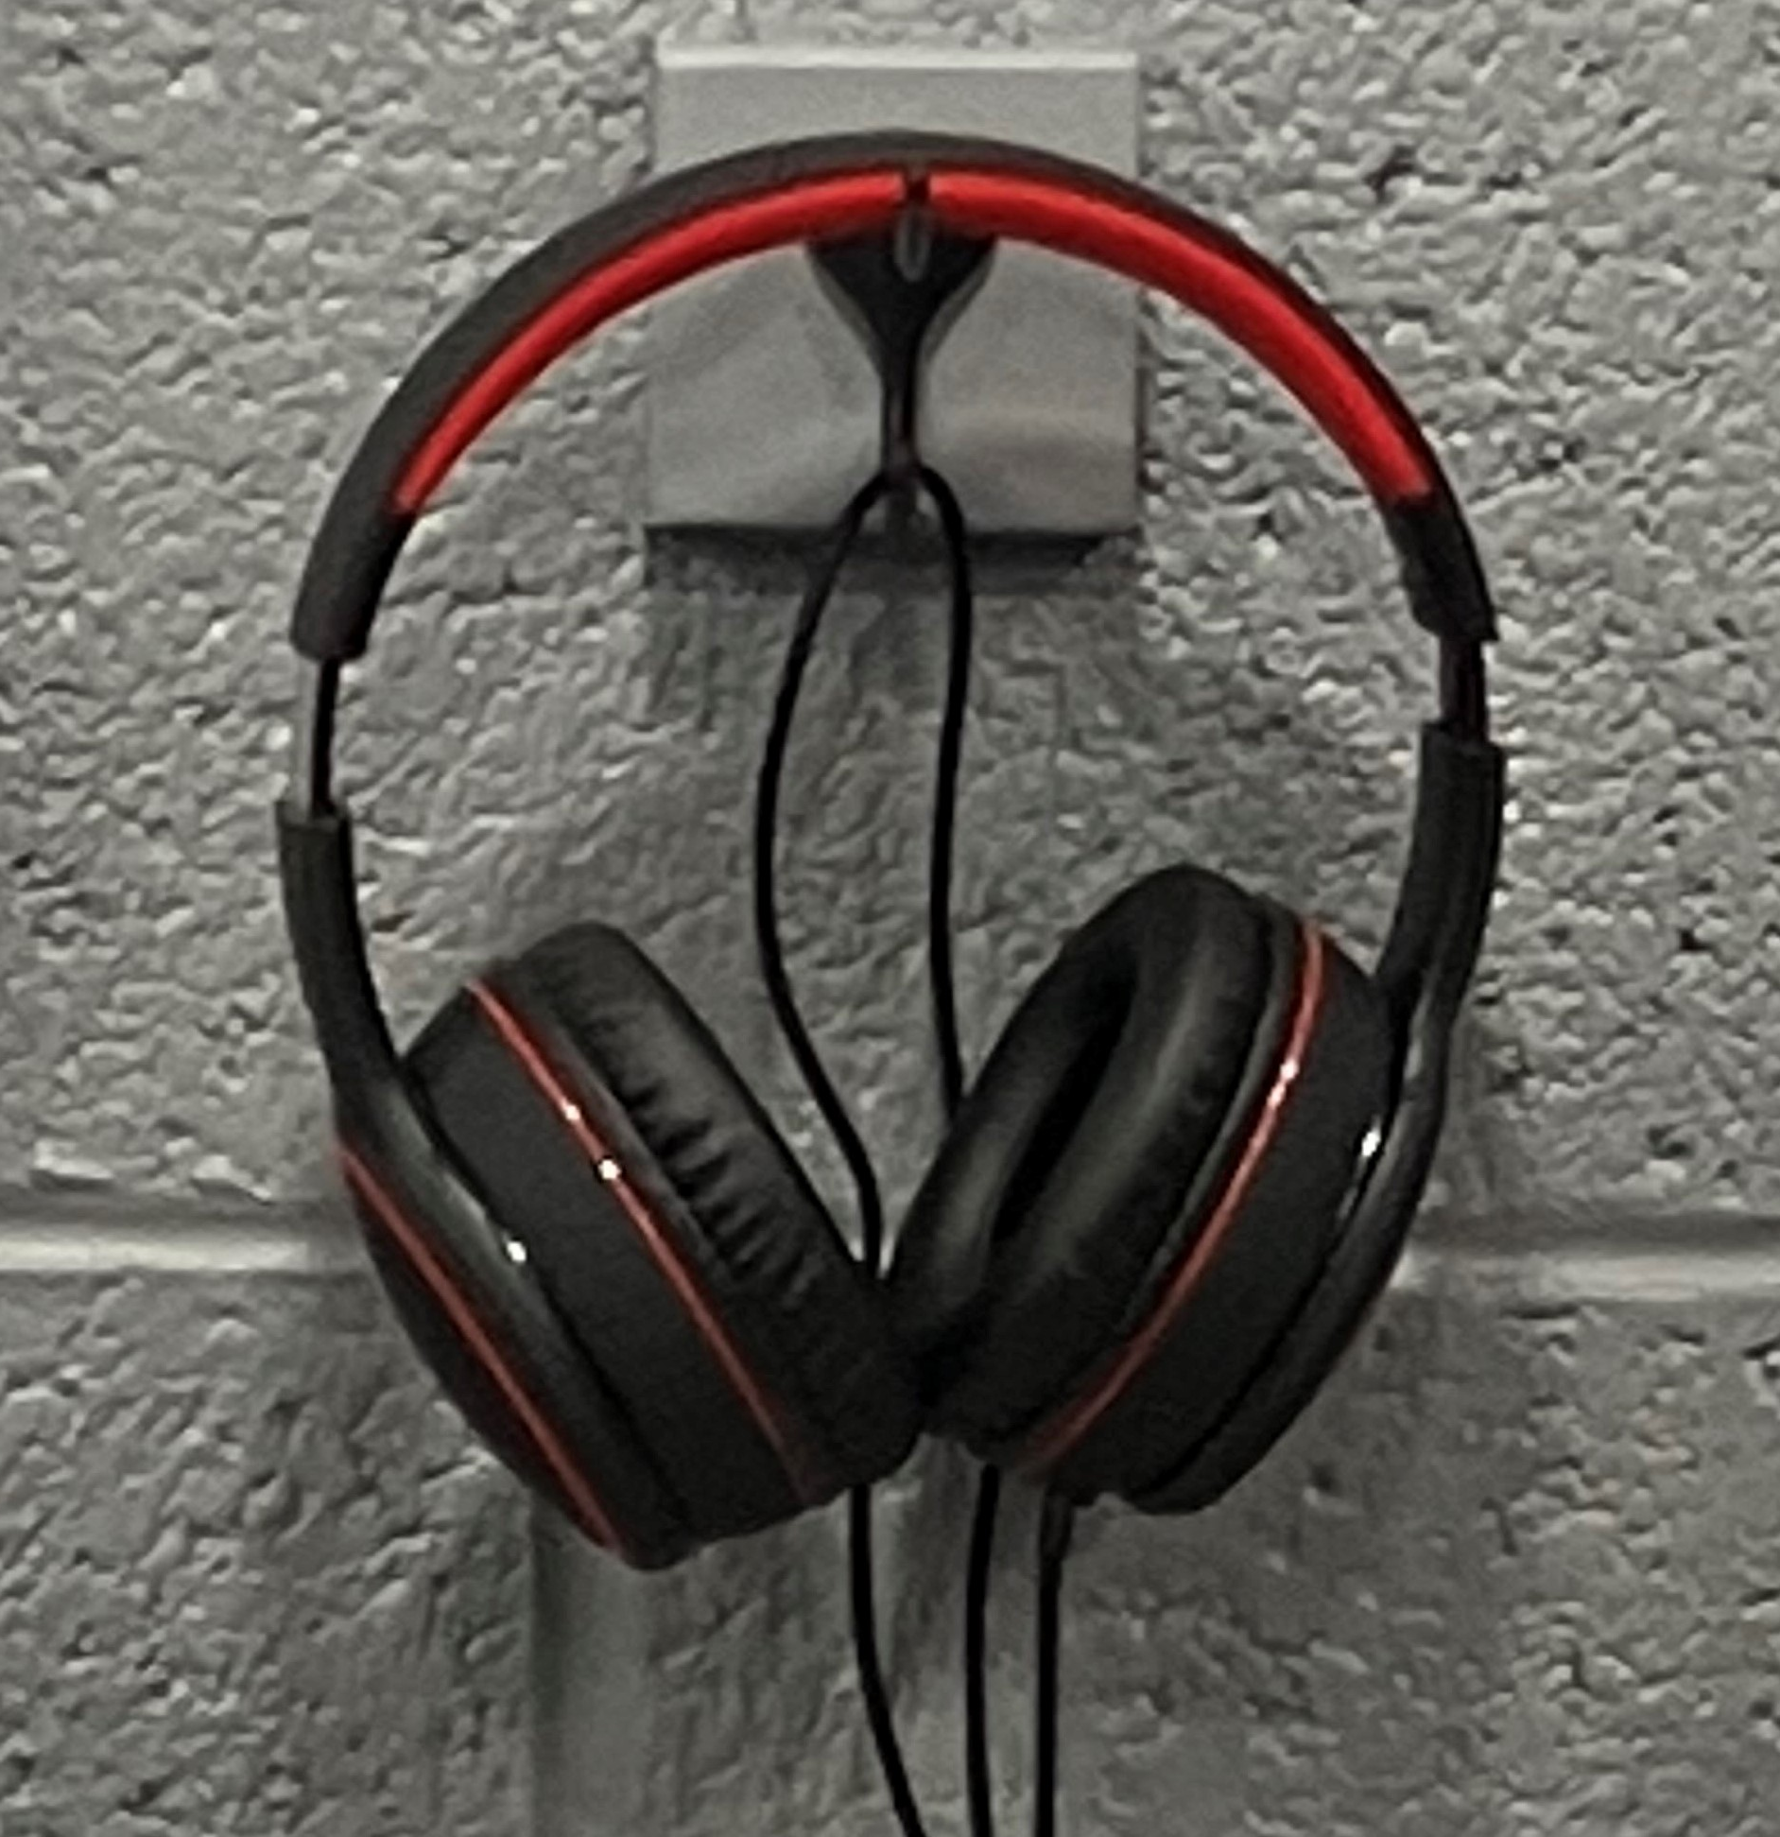

Want to Watch Videos?
PC’s 02 & 06 have headphones available for members to watch and listen to online training videos.
The volume is controlled on the computer. The Icon is in the lower right corner on the computer screen.

Slide 12
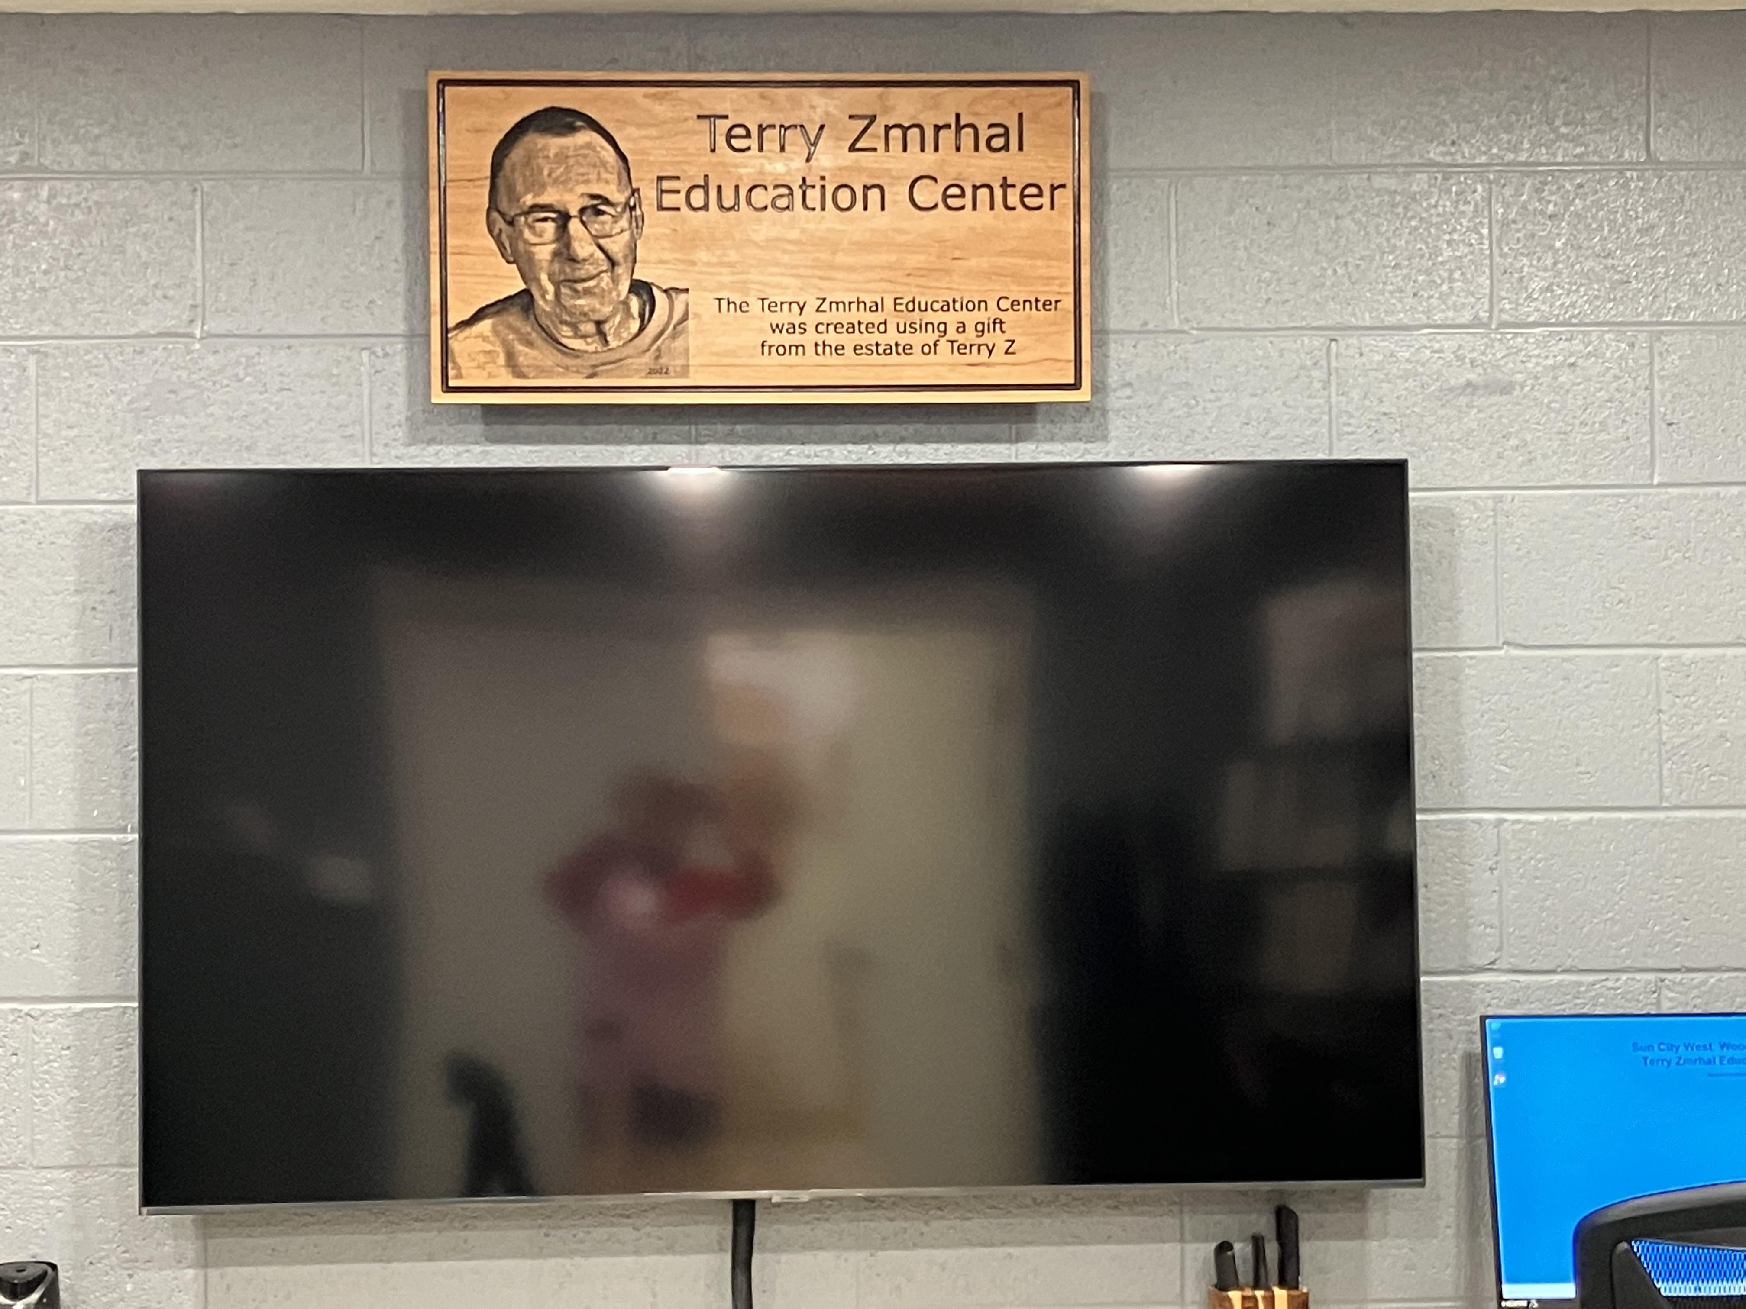
Big Screen TV
Computer #04 To the Right
of the Big Screen can project
its Screen Image onto the TV
Useful for Class Instructors using Visual aids.

Slide 13
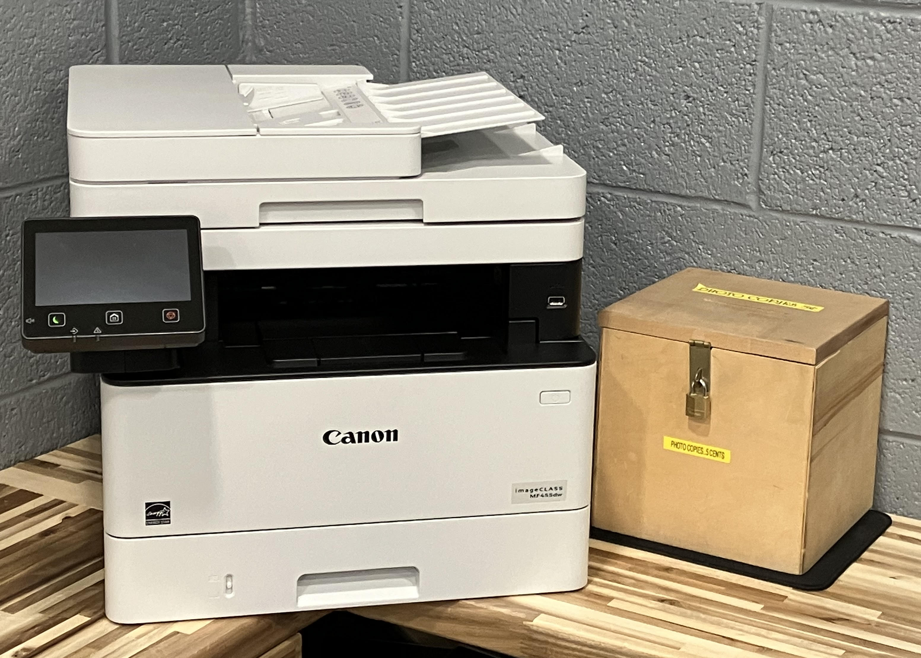
New Printer/Scanner/Copier
The Printer is accessible from every computer.
The box on the right is for contributions
for copies – 5 cents a copy, please.
Scanner App (NASPZ) on PC03

Slide 14
Vectorized Images
A mere 58,000 Vectorized Images have been uploaded and available to the membership. Thumbnails images are cataloged. The organization of the images to easily find them is in the incubator stage. More on that as it develops.
Useful to CNC folks since the images are vectorized they could go straight to toolpaths.

Slide 15
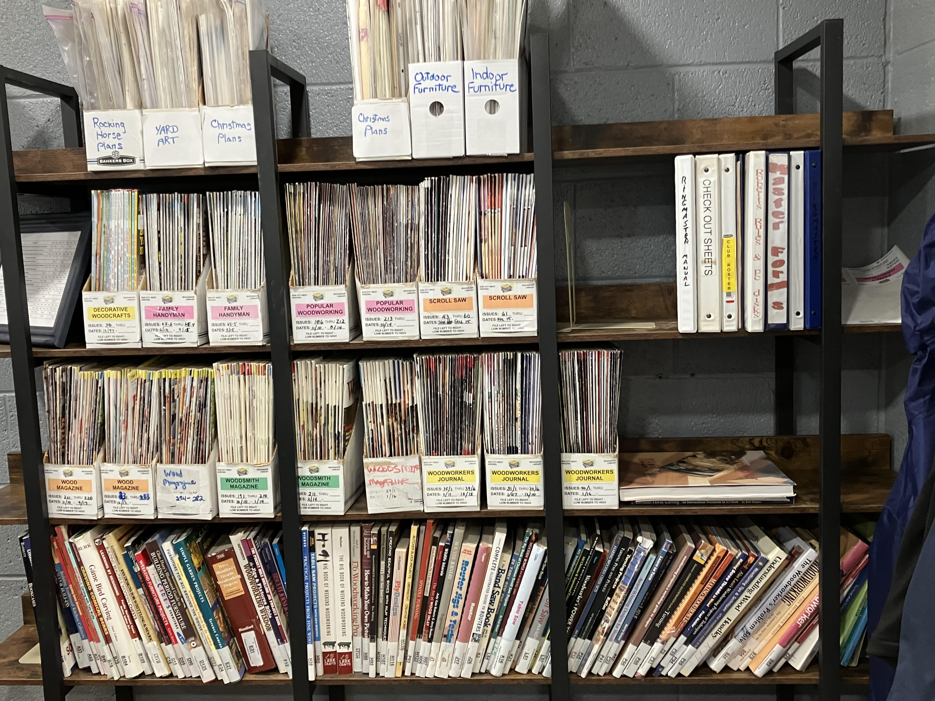
Traditional Library
Mike Ward, our Librarian, has done a great job to condense the books and magazines and preserved the ones most useful to members.
His goals for future improvements:
Magazine digital subscriptions
Improve book database for easier searching.
Clean up scroll saw patterns with an Index.
Reminder to members: There is a binder available to check out magazines.

Slide 16

What’s Ahead?
New Desktop Folder in the Launcher containing useful links to websites.
A compilation of instructional videos stored on flash drives for members to checkout.
Laser engraver to make logos for members to sign their artwork.
Additional software as needed for the
membership.
Looking for member’s wood artistry to display on the shelves in the library room.

Slide 17
Thank you
THANK YOU FOR YOUR ATTENTION. IT IS MY HOPE EVERYONE LEARNED A
LITTLE SOMETHING ABOUT WHAT EDUCATIONAL TOOLS ARE AVAILABLE TO
THE MEMBERSHIP. JUST ANOTHER THING THAT MAKES THIS CLUB GREAT.

